Slide 1




Our partners
PVC & Aluminium Systems
Window, door, sliding, facade, shutter and railing solutions
Windoor | Nikšić, Montenegro

Slide 2
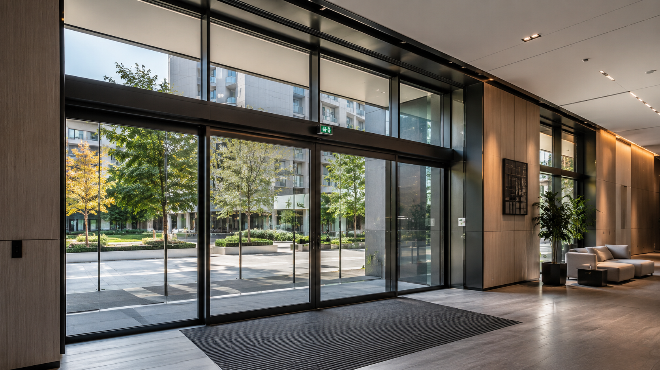
Windoor | Nikšić, Montenegro
01
Windoor at a glance
Production and installation partner for premium residential and commercial projects
Montenegro-based manufacturer and installer with more than 12 years of experience in PVC and aluminium joinery.
Our profile portfolio covers Kömmerling PVC systems, FEAL and Alumil aluminium systems, facades, shutters and railings.
We manufacture and install project-specific window, door, sliding and facade solutions for residential, commercial and public-sector buildings.
Full technical package available: catalogues, profile specifications, certificates / attests and complete project references upon request.
PVC
ALUMINIUM
FACADES
CERTIFICATES
Premium systems. Documented performance. Reliable execution.

Slide 3
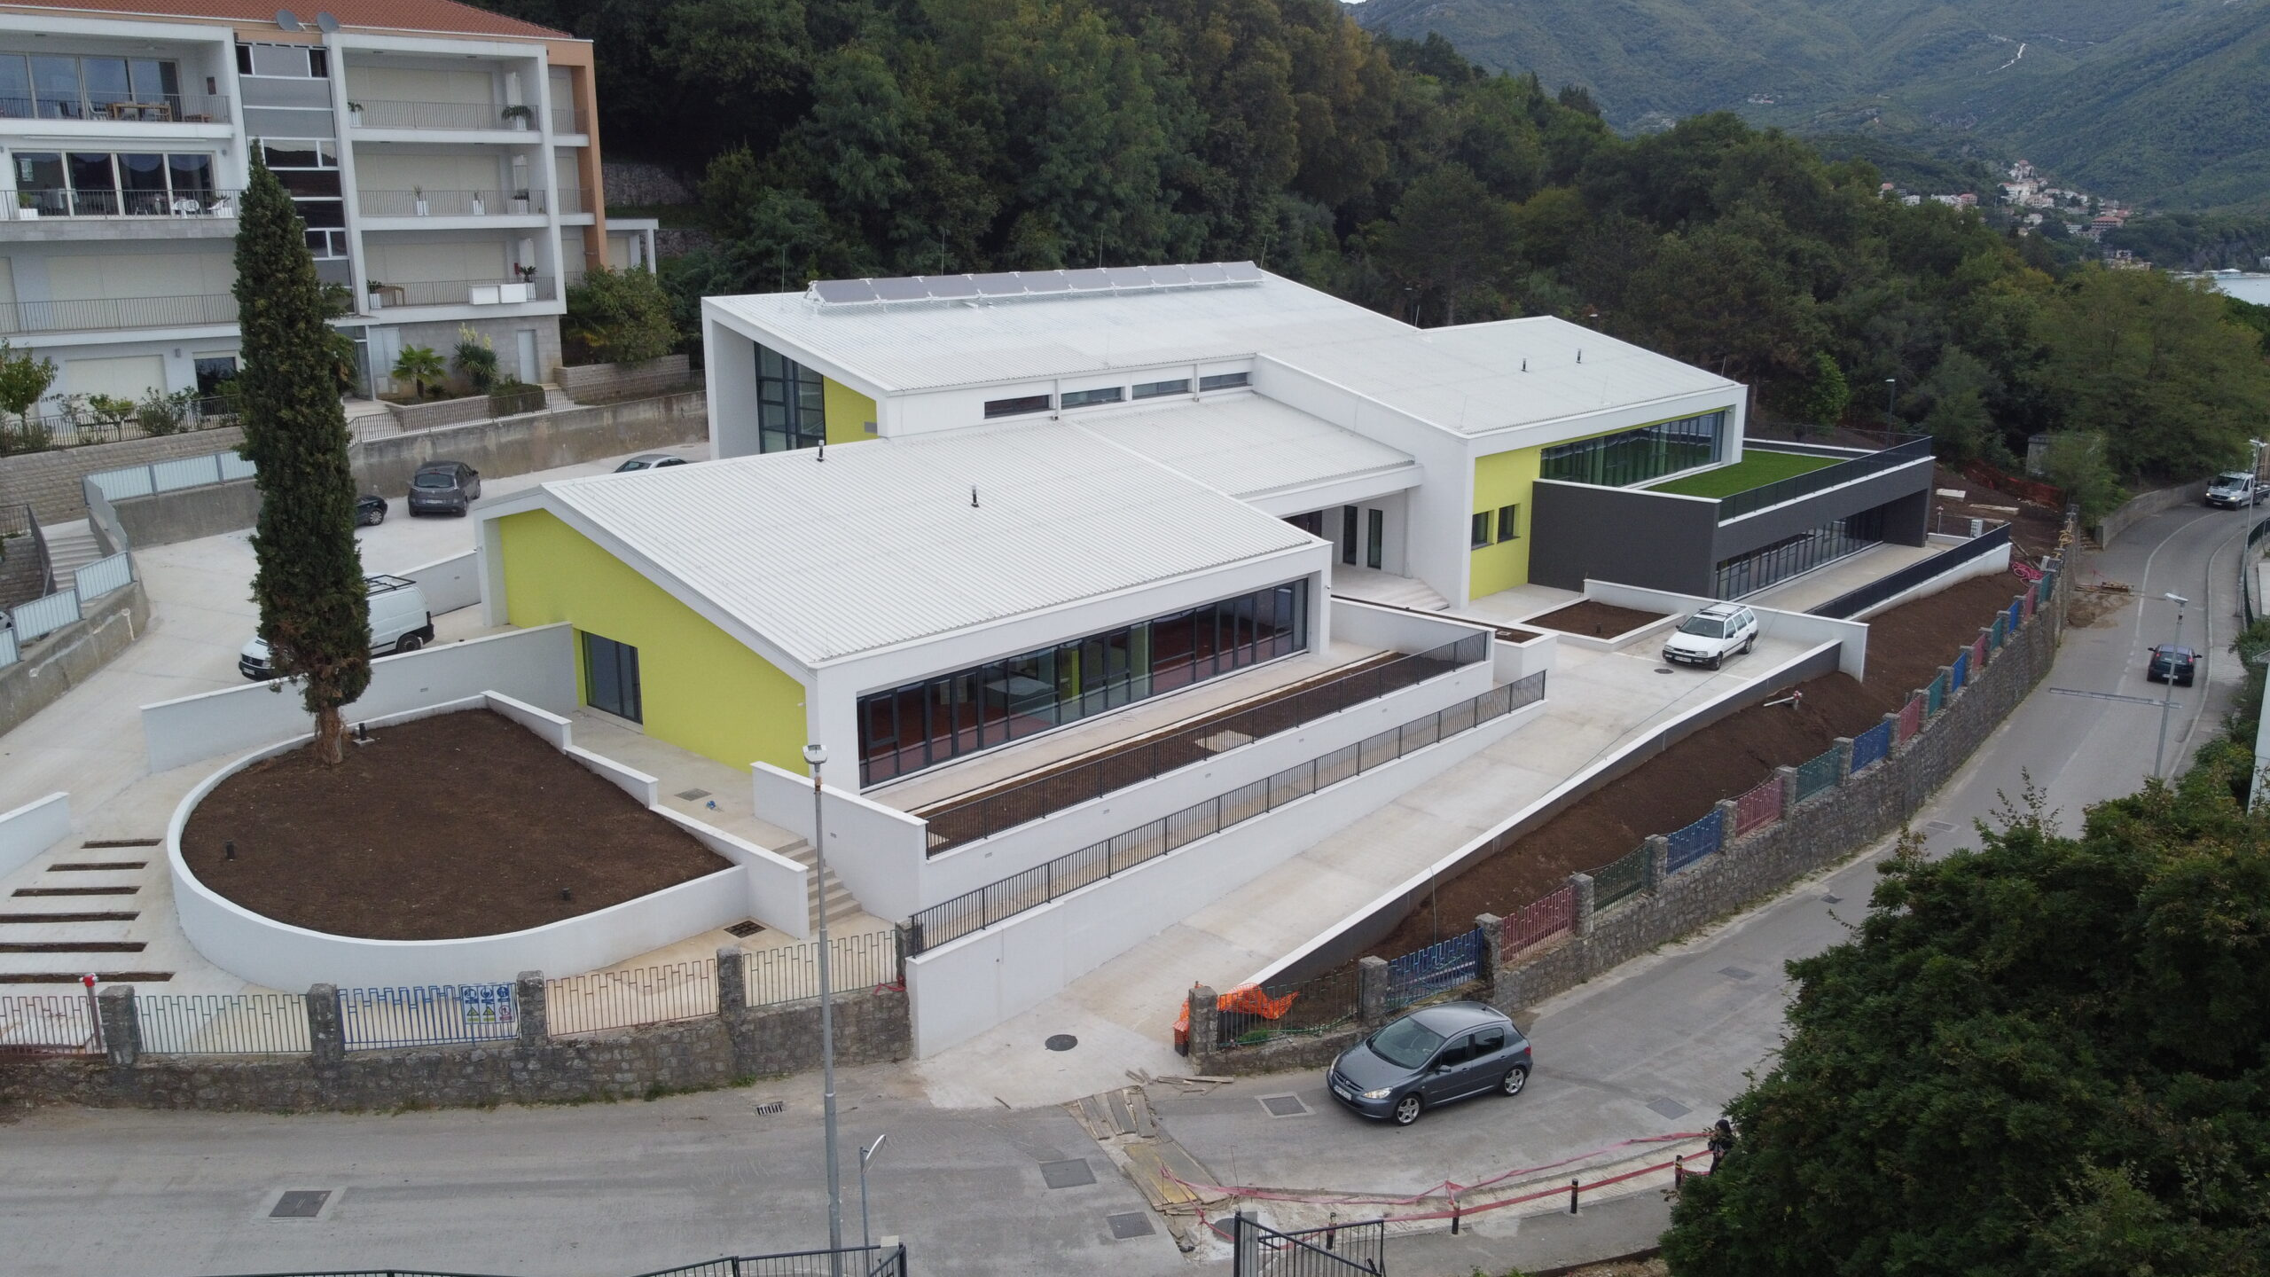
Windoor | Nikšić, Montenegro
02
Company capability & project execution
Profile systems, fabrication, installation and publicly financed energy-efficiency projects
PVC & ALUMINIUM
FACADES
SHUTTERS
RAILINGS
Our profile systems and execution scope
• PVC windows and doors based on Kömmerling profile platforms
• Aluminium windows, doors, sliding systems, facades, aluminium shutters and aluminium / glass railings
• Production, installation, documentation support and project-specific technical coordination
Internationally financed projects
Windoor has executed works on projects financed by KfW Bank and the World Bank in Montenegro, including energy-efficiency projects within Montenegro’s Energy Efficiency Programme.
One of the projects we completed, financed by KfW Bank
Premium systems. Documented performance. Reliable execution.

Slide 4
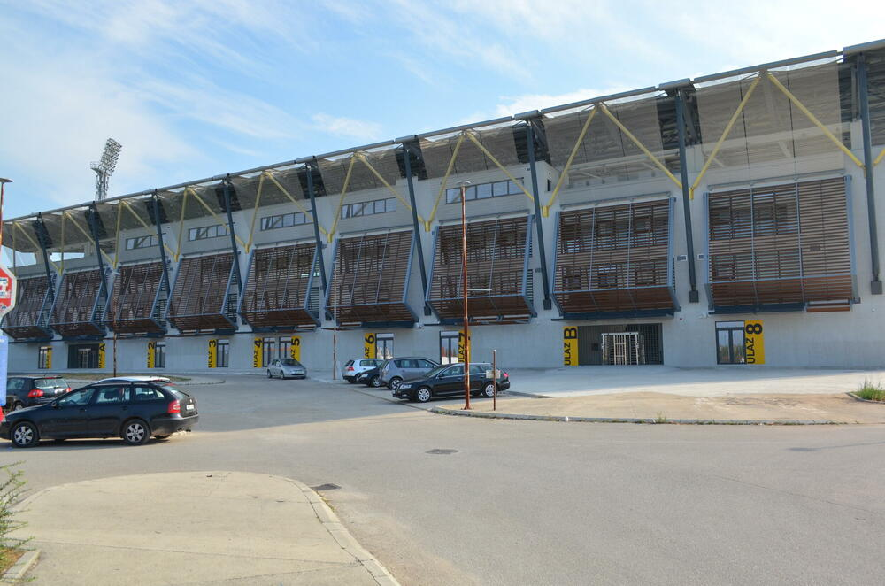
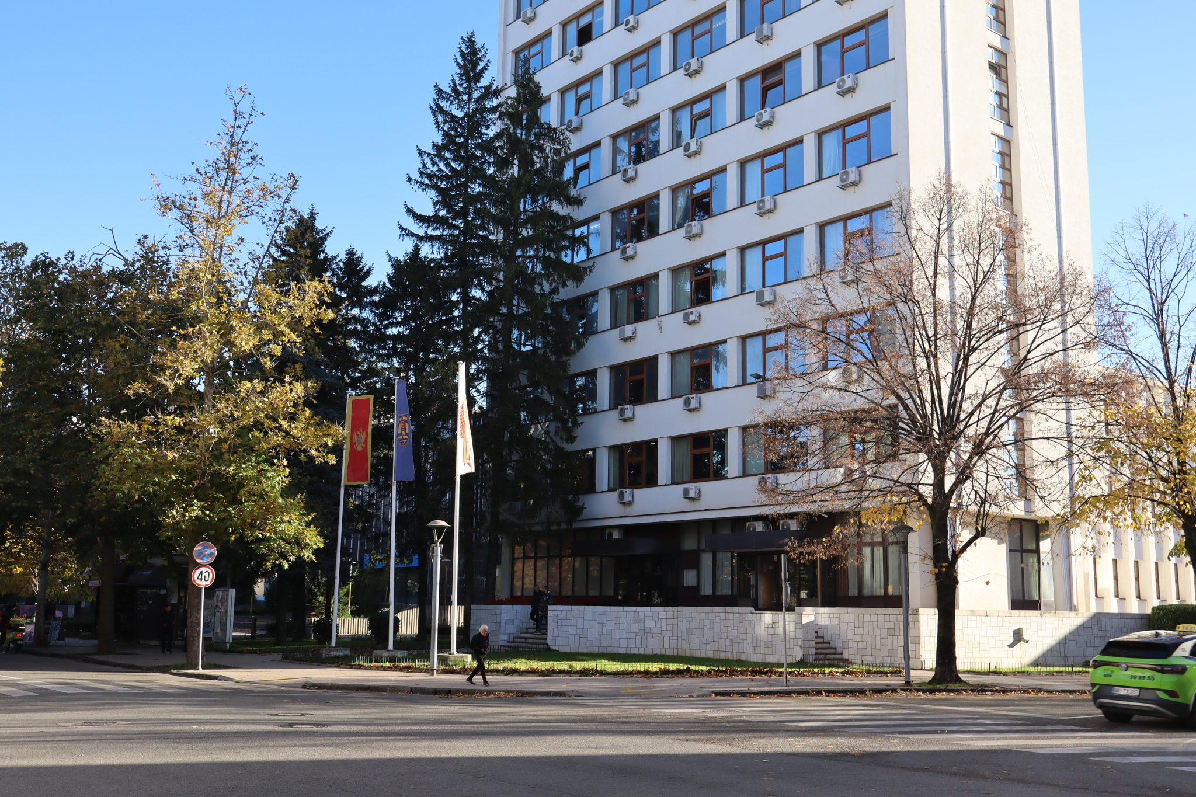
Windoor | Nikšić, Montenegro
03
Selected Windoor references
Examples only — complete reference list can be provided upon request
IMAGE PLACEHOLDER
IMAGE PLACEHOLDER
Nikšić — add project photo
Podgorica — add project photo
Sutjeska Stadium
Municipality Building
These references are part of a broader portfolio; complete documentation and additional references can be supplied if required.
Premium systems. Documented performance. Reliable execution.

Slide 5
Windoor | Nikšić, Montenegro
04
System portfolio
Profiles and solutions positioned for technical comparison
PVC systems
Aluminium windows & doors
Architectural aluminium
• Kömmerling 76 Centre Seal
• Kömmerling 88 Centre Seal
• Kömmerling 88 AluClip
• Kömmerling 88 proStratoTec
• Kömmerling PremiDoor 88 AluClip
• Alumil Supreme S91
• FEAL Termo 85 S Plus
• FEAL Termo 120 Plus — sliding / lift-and-slide systems
• FEAL FK50 facade / structural glass facade system
• FEAL aluminium shutters
• FEAL aluminium and glass railings
Final system selection depends on opening type, dimensions, glazing, target U-values, acoustic requirements and project market standards.
Premium systems. Documented performance. Reliable execution.

Slide 6
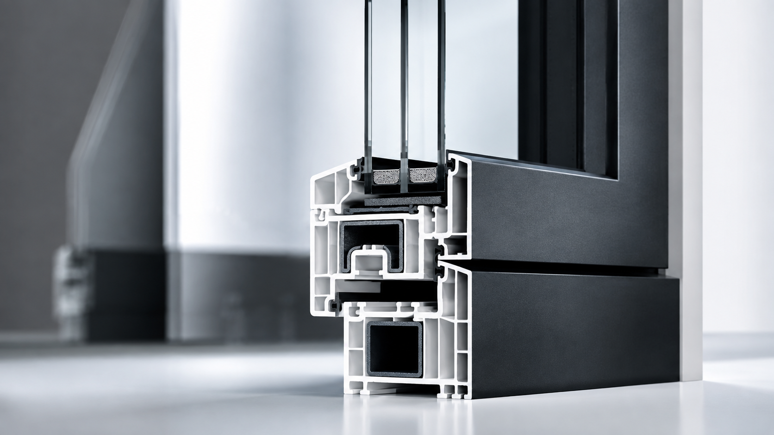
Windoor | Nikšić, Montenegro
05
Kömmerling 76 Centre Seal
Premium performance in a slim 76 mm installation depth
76 mm centre-seal PVC-U system intended for efficient windows and doors.
Glass packages up to 56 mm, suitable for high thermal insulation and sound insulation requirements.
Can be used up to RC 2 security class according to Kömmerling documentation.
Good insulation values: Uf value up to 1.0 W/(m²K), depending on combination.
Large variety of decors; updated design based on the AluClip Plus visual language.
Attests / documentation
PVC-U WINDOWS & DOORS
Official Kömmerling 76 product page and brochure, thermal values, glazing range, security documentation and colour / décor documentation.
Premium systems. Documented performance. Reliable execution.

Slide 7
Windoor | Nikšić, Montenegro
06
Kömmerling 88 Centre Seal & AluClip
Premium 88 mm PVC platform with aluminium-clad option
88 mm construction depth with high-insulation seven-chamber centre-seal design.
Wide glazing range up to 58 mm for triple and functional glazing.
AluClip option combines PVC thermal insulation with aluminium exterior cladding.
Passive-house suitability and documented Uf / Uw performance values in official Kömmerling documentation.
Attests / documentation
Kömmerling 88 Centre Seal brochure, Kömmerling 88 AluClip brochure, WA-15/2 / passive-house-related documentation and profile specifications.
88 MM PREMIUM PVC
Premium systems. Documented performance. Reliable execution.

Slide 8
Windoor | Nikšić, Montenegro
07
Kömmerling 88 proStratoTec
Passive-house windows in colour with integrated glass-fibre reinforcement
Variant for the Kömmerling 88 MD and 88 AD systems.
Integrated Ultradur® glass-fibre reinforcement improves sash stability and reduces the need for steel reinforcement.
Manufacturer documentation states Uf = 0.79 W/(m²K) with insulating inserts, insulated sill connection and glass bonding.
Designed for coloured passive-house windows, including larger sash sizes and room-high window walls.
Can be used where premium thermal performance and coloured profile aesthetics are required.
Attests / documentation
PROSTRATOTEC
Kömmerling 88 proStratoTec official product page, PHI / Dr. Feist passive-house certification references, technical documentation and safety data sheets where applicable.
Premium systems. Documented performance. Reliable execution.

Slide 9
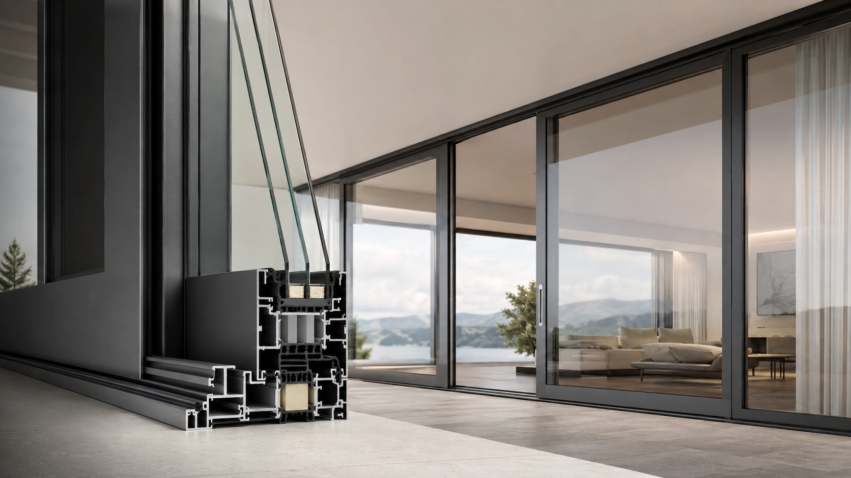
Windoor | Nikšić, Montenegro
08
Kömmerling PremiDoor 88 AluClip
Large-format lift-and-slide openings
Premium lift-and-slide platform for villas, apartments, hotels and commercial areas requiring panoramic glazing.
Triple glazing configurations supported by the system documentation.
Aluminium exterior appearance with strong thermal performance from the PVC system base.
Appropriate for wide openings, comfort operation and high architectural requirements.
Attests / documentation
Official product page, system brochure package, glazing limits, sash-weight limitations, drainage details and hardware data sheets.
Premium systems. Documented performance. Reliable execution.

Slide 10
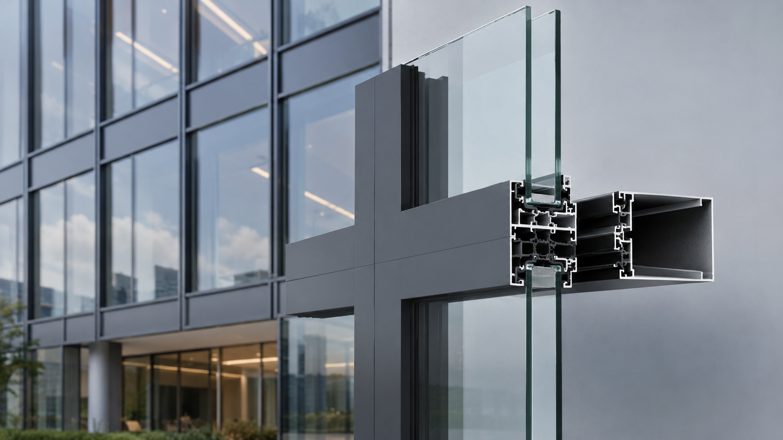
Windoor | Nikšić, Montenegro
09
Aluminium systems — expanded scope
FEAL systems added and terminology translated fully into English
Alumil Supreme S91 — premium aluminium window and door system.
FEAL Termo 85 S Plus — high-insulation aluminium windows and doors.
FEAL Termo 120 Plus — sliding and lift-and-slide systems for large openings.
FEAL FK50 — facade / structural glass facade system.
FEAL aluminium shutters — English term for grilje.
FEAL aluminium and glass railings — English term for ograde.
Certificate coverage
Manufacturer system attests, laboratory testing standards, AWW / facade performance classifications, ISO production certificates and coating / finish certificates.
Premium systems. Documented performance. Reliable execution.

Slide 11
Windoor | Nikšić, Montenegro
10
FEAL Termo 85 S Plus
High-performance thermally broken aluminium window and door system
Frame depth 85 mm; sash depth 93 mm; filling depth up to 79 mm.
Thermal break with 45 mm polyamide strips and EPDM sealing.
Manufacturer-stated AWW performance: EN 12207 class 4, EN 12208 class E1500, EN 12210 class C5/B5.
Suitable for high-quality residential and commercial window / door openings.
Attests / documentation
FEAL technical catalogue / system PDF, air / water / wind classification standards, material declarations, coating certificates and quality-control references.
Premium systems. Documented performance. Reliable execution.

Slide 12
Windoor | Nikšić, Montenegro
11
FEAL Termo 120 Plus
Sliding and lift-and-slide systems for large glazed openings
Advanced sliding / lift-and-slide system for energy-efficient windows and doors.
Double-, triple- and quadruple-leaf configurations within the Termo 120 family.
Thermally broken profile system with additional insulation elements.
AWW performance and sash-load data should be verified by exact project configuration.
Attests / documentation
FEAL Termo 120 catalogue / product page, lift-and-slide hardware documentation, glazing limits, sash-load tables and threshold / drainage details.
Premium systems. Documented performance. Reliable execution.

Slide 13
Windoor | Nikšić, Montenegro
12
FEAL FK50 facade system
Structural / stick glass facade profile system
Aluminium system for self-supporting and glazed facades.
50 FK family with visible profile width around 50 mm.
Manufacturer-stated facade attest classes include EN 12152 air permeability, EN 12154 watertightness and EN 13116 wind resistance.
Appropriate for commercial, residential and mixed-use architectural facades.
Attests / documentation
Facade catalogue, CE / EN 13830-related documents, static calculations, glass certificates, sealing and installation documentation.
Premium systems. Documented performance. Reliable execution.

Slide 14
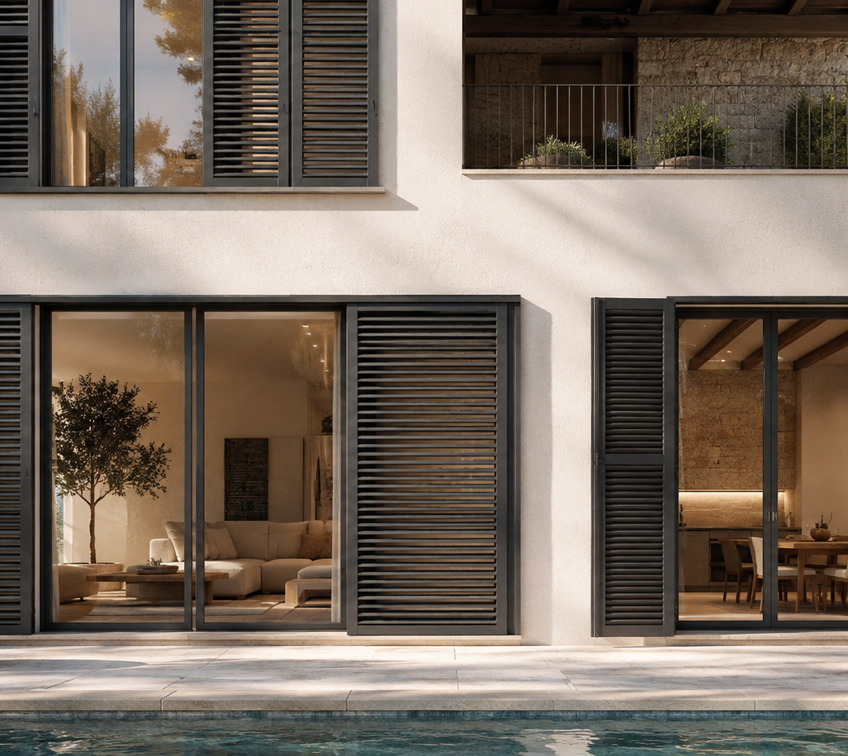
Windoor | Nikšić, Montenegro
13
FEAL aluminium shutters
Sun protection systems for windows, doors, terraces and balconies
English terminology: shutters, aluminium shutters or louvered shutters.
Applications: windows, doors, balconies, verandas and privacy / solar-control openings.
Configurations may include movable slats, fixed slats or full filling.
Surface options include RAL colours, anodized finish and wood imitation according to FEAL documentation.
Attests / documentation
Catalogue for the selected shutter model, wind-resistance references where applicable, material declarations and surface-treatment certificates.
Premium systems. Documented performance. Reliable execution.

Slide 15
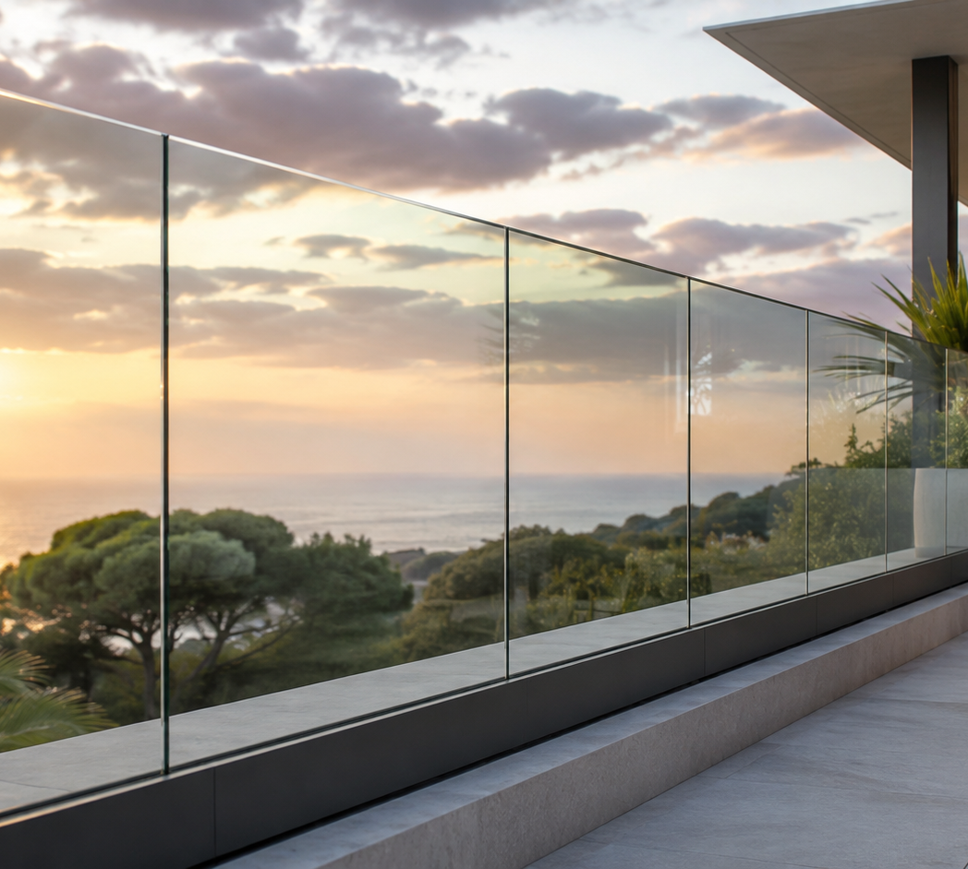
Windoor | Nikšić, Montenegro
14
FEAL aluminium and glass railings
Railing systems for balconies, stairs and terraces
English terminology: railings, balcony railings, stair railings or glass railings.
Aluminium railing profiles and connecting elements for balconies and staircases.
Glass railing options for modern transparent terrace and balcony designs.
Project-specific verification should cover loads, fixing substrate, glass type and local railing requirements.
Attests / documentation
FEAL railing catalogue / system detail, glass certificate, static calculation and fixing / substrate details for selected configuration.
Premium systems. Documented performance. Reliable execution.

Slide 16
Windoor | Nikšić, Montenegro
15
Alumil Supreme S91
Premium aluminium system positioned for passive-house projects
Thermally insulated hinged aluminium system designed for high energy efficiency.
Supreme S91 Hi version is certified by the Passive House Institute according to Alumil documentation.
Production certifications include ISO 9001:2015 by TÜV NORD CERT.
Suitable for premium windows and entrance doors where high thermal and acoustic performance are required.
Attests / documentation
S91 product catalogue and performance data, PHI certificate / Passive House documentation, production certification and coating / material certificates.
Premium systems. Documented performance. Reliable execution.

Slide 17
Windoor | Nikšić, Montenegro
16
Manufacturer certificates / attests
FEAL production and quality-control certificates
ISO 9001:2015
ISO 14001:2015
EN 15088:2006
EN 1090-3:2009
EN ISO 3834-2
EN 15085-2
GSB International
Qualicoat
Qualideco
Qualanod
Environmental Product Declaration (EPD)
Green Dot
CERTIFICATES
/ ATTESTS
Use in the final proposal
Attach the exact certificate PDFs requested by the client/project: profile catalogue, material declarations, AWW / facade tests, production ISO certificates and finish certificates.
Premium systems. Documented performance. Reliable execution.

Slide 18
Windoor | Nikšić, Montenegro
17
Recommended certificate pack by profile type
What should be attached when sending the presentation
PVC / Kömmerling
Aluminium windows / doors
Sliding systems
System brochure
Passive-house / PHI docs where applicable
Thermal values and glazing range
Colour / AluClip information
FEAL or Alumil catalogue
Air / water / wind classes
Uw / Uf thermal calculations
Material and coating certificates
Termo 120 / PremiDoor catalogue
Glazing and sash-load limits
Hardware data sheets
Threshold and drainage details
Facades FK50
Aluminium shutters
Railings
Facade catalogue
EN 12152 / EN 12154 / EN 13116 data
Static calculation
Glass and sealing documents
Model catalogue
Wind / material references
Surface finish certificate
RAL / anodized / wood imitation options
Railing catalogue
Static calculation
Glass certificate
Fixing / substrate details
Premium systems. Documented performance. Reliable execution.

Slide 19
Windoor | Nikšić, Montenegro
18
Documentation links
Official manufacturer pages and catalogues for client review
Kömmerling 76 Centre Seal
https://www.koemmerling.com/en/products/pvc-u/fit-for-future/koemmerling-76-centre-seal-premium-performance-in-a-slim-installation-depth/
FEAL Termo 120 Plus
https://feal.ba/en/systems/aluminium-windows-and-doors/
Kömmerling 88 Centre Seal
https://www.koemmerling.com/cms16/files/Koemmerling-88-centre-seal-main-brochure-2421130370-0825-web.pdf?download=1
FEAL FK50
https://feal.ba/en/systems/facades/
Kömmerling 88 AluClip
https://www.koemmerling.com/cms16/files/Koemmerling-88-centre-seal-AluClip-brochure-2421130372-0323-web.pdf?download=1
FEAL aluminium shutters
https://feal.ba/en/systems/shutters/
Kömmerling 88 proStratoTec
https://www.koemmerling.com/en/products/pvc-u/window-residential-door-systems/88-mm-systems/koemmerling-88-centre-seal/koemmerling-88-prostratotec-passive-house-windows-in-color-certified-by-phi-dr-feist/
FEAL aluminium and glass railings
https://feal.ba/en/systems/railings/
Kömmerling PremiDoor 88 AluClip
https://www.koemmerling.com/en/products/pvc-u/sliding-systems/lift/sliding-systems/premidoor-88/aluclip-5/
Alumil Supreme S91
https://www.alumil.com/greece/en/aluminium-systems/all-architectural-aluminium-systems/hinged-insulated-system-supreme-s91
FEAL Technical Catalogues
https://feal.ba/en/technical-catalogs/
Alumil certifications
https://www.alumil.com/greece/en/company/certifications
FEAL Termo 85 S Plus
https://feal.ba/wp-content/uploads/2025/katalozi/aluminijski-prozori-i-vrata/TERMO-85-S-Plus.pdf
Premium systems. Documented performance. Reliable execution.

Slide 20
Windoor | Nikšić, Montenegro
19
Certificate / attest coverage by profile type
What is included for technical review and final project documentation
PVC — Kömmerling 76 / 88 / AluClip
Official product pages, brochures, ISO 9001, environmental certificates and EPD references.
PVC — Kömmerling 88 proStratoTec
PHI / Passive House documentation, proStratoTec brochure and 88 MD / 88 AD system compatibility.
PVC sliding — PremiDoor 88 AluClip
Lift-and-slide product documentation, glazing compatibility and technical catalogue references.
Aluminium — FEAL Termo 85 S Plus
Product page, catalogue, AWW performance references and FEAL quality-control certificates.
Aluminium sliding — FEAL Termo 120 Plus
Sliding / lift-and-slide system documentation and FEAL certificates / attest source page.
Facades — FEAL 50 FK
Facade product page, facade catalogue and EN air / water / wind / structural attest references.
Aluminium shutters
FEAL shutter product page, catalogue and surface-protection certificate references.
Aluminium / glass railings
FEAL railing systems documentation, glass / static calculation requirements and finish certificates.
Alumil Supreme S91
Product page, Passive House information and Alumil certifications page.
COMPLETE PACK AVAILABLE
Exact PDFs and project-specific declarations can be supplied with the final offer, according to the requested system and opening schedule.
Premium systems. Documented performance. Reliable execution.

Slide 21
Windoor | Nikšić, Montenegro
20
Verified documentation links
Clickable official manufacturer pages for all profile groups in the presentation
Kömmerling 76 Centre Seal — product page
FEAL Technical Catalogues
Kömmerling 88 Centre Seal — main brochure
FEAL Quality Control — certificates / attests
Kömmerling 88 AluClip — brochure
FEAL Termo 85 S Plus — product page
Kömmerling 88 proStratoTec — product page
FEAL Termo 120 Plus — sliding / lift-and-slide
Kömmerling proStratoTec — brochure PDF
FEAL 50 FK — facade system
Kömmerling PremiDoor 88 AluClip — product page
FEAL G 45 — aluminium shutters
Kömmerling environmental / ISO certificates
FEAL railings — aluminium / glass systems
Alumil Supreme S91 — product page
Alumil company certifications
All system groups shown in this presentation now have an official documentation source and certificate / attest source listed. The final tender pack can include the exact PDFs required for each project position.
Premium systems. Documented performance. Reliable execution.

Slide 22
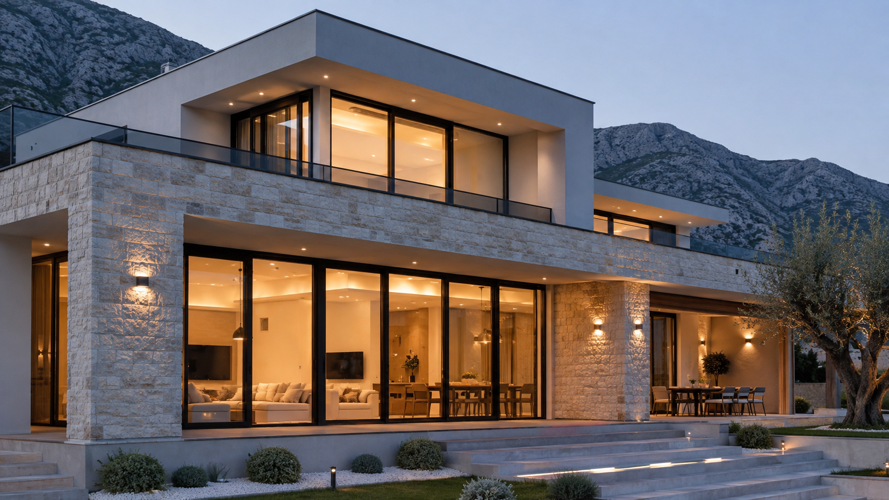
21
Next step
After the technical team confirms target openings and reference Internorm systems, Windoor can prepare a direct profile-to-profile comparison with complete attests and certificates attached.
Luka Milović | Windoor | Nikšić, Montenegro

